Slide 1
Walmart CONVERGE sparkathon 2023

Slide 2
TEAM – ANALYZER
THEME – DATA
TEAM MEMBERS
1) H.L.SANTHOSH
2) M.KARTHIKEYAN

Slide 3
AGENDA
→ Introduction​
→ Problem Statement
​→ Solution Explanation
​→ Summary​

Slide 4
Introduction
→ Integrating customer retention rate and buying behavior analysis software at Walmart's physical bill centers marks a transformative step in enhancing customer service.
→ This innovation merges cutting-edge data analytics with personalized experiences, enabling us to tailor interactions and recommendations based on individual shopping patterns.
→This initiative reinforces Walmart's commitment to providing unparalleled service, creating a retail experience that seamlessly bridges the physical and digital realms for our valued customers.

Slide 5
PROBLEM STATEMENT
→ Current customer service at Walmart's physical bill centers lacks integration of retention rate and buying behavior analysis software.
→ Missing connection hampers personalization and tailored recommendations for customers.
→ Need for a solution that combines data analytics and real-time interactions to enhance customer retention and satisfaction.
→ Integration of software aims to optimize customer experience, drive loyalty, and improve overall shopping journey.

Slide 6
IMPLEMENTATION OF FOLLOWING ANALYTICS IN PHYSICAL AND ONLINE RETAIL SHOPPING
Customer Buying behaviour and Feedback Analysis, Future Sales Prediction ,Customer Acquisition Cost and Retention Rate for Online and Offline Stores, Yearly, Monthly, Weekly Data Collection and Analysis
Accurate Recommendation of Products to customers
→Profile creation for customers at Offline stores and connect it with online Walmart account and updation of their offline and online store purchases and managing it in single account
→Recommendation of more offers and showcasing the desired product based on the data analysis which improves purchase rate and footstep count to stores

Slide 7
Special features
Shop products at Offline store and the bill will be displayed at online account so that the customer can pay it via online payment services.
Shop products at Online app or website and pay the bill at offline store, if required the customer can collect the items at nearest Walmart stores.
The members of a family can have an integrated account , they can purchase at any time and connected with membership so that the payment can be made by any member of the family,
For example If wife purchases at Walmart offline store so that the bill will be shared to the integrated accounts , so that Husband pays the amount with single click.
Cart sharing with friends and family, so with one click they can purchase the whole cart .
Discount sale sharing with friends and family.
Product sharing with the friends and family.
The offline store bills and online store bills history are available at app.

Slide 8
OFFLINE STORE FEATURES
Collection and Analysis and Insights about of Data about :
Customer profile creation which stores all data, Customer buying capacity.
Frequency of buying at regular intervals, Positive and Negative Feedback.
Which product sells more at which time duration, Which product least preferred by customer, Which product liked by which age groups and Gender specific products.
→Entire retail store activity analysis and tracking of store management and Generate insights to improve based on overall activity and customer feedback

Slide 9
Online STORE FEATURES
→Easy integration with the offline store account and sync with online and offine purchases
→Strong Personalized recommendation based on account information and user activity
→Diet Recommendation System for Grocery shopping
→Personalized Recommendation for exclusive deals and offers
→Personalized ads based on the user activity
→Providing deals both at Offline and Online stores.

Slide 10
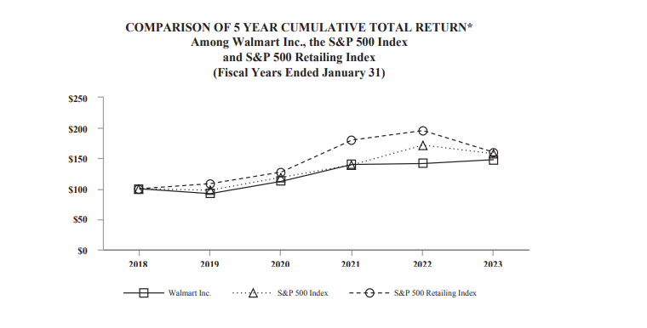
OFFLINE STORE PERFORMANCE ANALYSIS

Slide 11
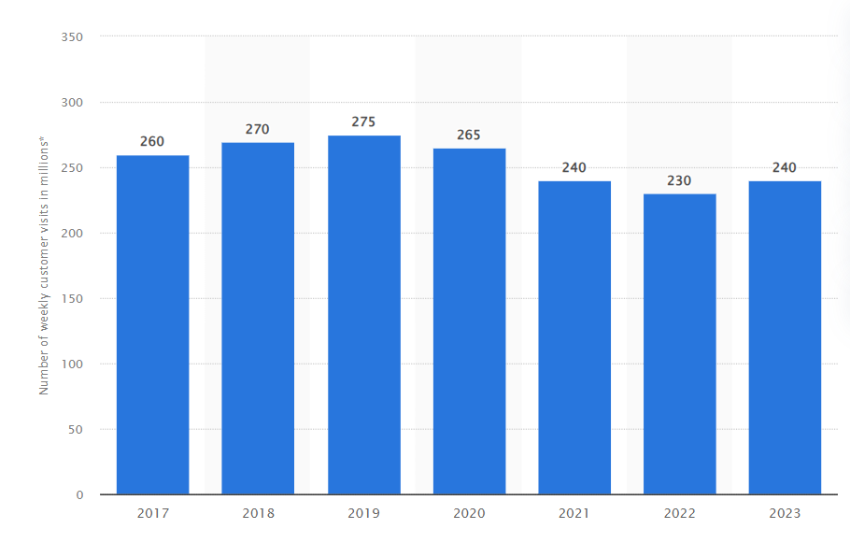
OFFLINE STORE WEEKELY VISIT ANALYSIS

Slide 12
PROPOSED SOLUTION
1) Implement an integrated analysis software system at Walmart's physical stores to enhance customer experience.
2) Automatically create customer accounts during offline store purchases to track and analyze their behavior.
3) Gather comprehensive purchase details and customer preferences to generate insights for improving services.
4) Analyze customer behaviors, such as preferred products and frequency of visits, to understand buying patterns.
5) Use data analytics to identify areas of improvement and enhance the overall shopping experience.

Slide 13
PROPOSED SOLUTION
6) Link offline store accounts with online purchases to create a unified customer profile.
7) Provide real-time insights to store staff to offer personalized recommendations and assistance.
8) Utilize the collected data to optimize product placement, pricing strategies, and marketing campaigns.
9) Enhance customer loyalty by tailoring promotions and offers based on individual preferences.
10) Continuously refine the analysis system based on feedback and evolving customer needs.

Slide 14
TECHNICAL FEASIBLITY
Unified Data Integration: Seamlessly integrate offline and online customer data, enabling a holistic view of their behavior and preferences.
Scalable Cloud Solutions: Leverage scalable cloud infrastructure to efficiently handle large data volumes, ensuring smooth processing and analysis.
Advanced Analytics: Utilize sophisticated data processing and machine learning algorithms for real-time analysis, generating valuable insights.
Predictive Personalization: Employ machine learning models to predict customer preferences, enabling personalized recommendations.
Intuitive Interface: Develop user-friendly interfaces for staff to access insights and implement data-driven improvements in-store.

Slide 15
SCALABILITY OF THE SOLUTION
Data Handling Capacity: The proposed solution is designed to handle substantial increases in data volume, ensuring smooth operation even during peak times.
Elastic Cloud Resources: Our cloud-based architecture allows for easy scaling up or down of computing resources based on demand, ensuring optimal performance.
Load Balancing: Implement load balancing mechanisms to distribute processing tasks efficiently, preventing system overload and bottlenecks.
Distributed Processing: Utilize parallel processing techniques to distribute data analysis tasks across multiple servers, enhancing efficiency.
Auto-scaling Mechanism: Implement auto-scaling features that automatically adjust resource allocation in response to fluctuations in usage, maintaining consistent performance.

Slide 16
Impact and benefit TO WALMART
Enhanced Customer Experience: Tailored shopping experiences based on in-depth analysis of customer preferences, leading to increased loyalty and satisfaction.
Data-Driven Decisions: Real-time insights guide strategic decisions, optimizing product placements, pricing, and promotions for better sales outcomes.
Operational Efficiency: Automated data collection reduces manual effort, allowing staff to focus on key tasks, enhancing store efficiency.
Seamless Integration: Bridging offline and online data for consistent customer experiences, fostering engagement across channels.
Competitive Edge: Utilizing advanced analytics positions Walmart as a retail leader, adapting swiftly to trends, customer demands, and industry changes.

Slide 17
Innovation and creativity
Novel Data Fusion: Integrating offline and online purchase data offers a holistic view of customer behavior, facilitating personalized strategies.
Automated Customer Profiles: Creating dynamic customer profiles based on purchase history enhances engagement and tailors marketing efforts.
Predictive Analytics: Leveraging AI to forecast trends, enabling Walmart to proactively address customer needs and adapt its offerings.
Real-time Insights: Harnessing cutting-edge technology provides immediate feedback, fostering agile decision-making and adaptive strategies.
Unified Customer Experience: Merging offline and online interactions through innovative software elevates Walmart’s brand image and customer satisfaction.

Slide 18
SIGNIFICANCE OF THE PROBLEM
Enhanced Customer Engagement: Understanding customer behavior empowers Walmart to offer personalized experiences, fostering loyalty and repeat business.
Competitive Edge: Utilizing advanced analytics positions Walmart as an industry leader, setting new standards for customer service and satisfaction.
Data-Driven Decisions: Accurate insights into customer preferences aid in optimizing inventory, improving operational efficiency, and reducing costs.
Holistic Business Growth: The integration bridges the gap between offline and online, promoting seamless shopping experiences, driving revenue, and attracting new customers.
Customer-Centric Approach: Addressing customer needs and preferences is pivotal for sustainable growth, and this solution enables Walmart to do so with precision and innovation.

Slide 19


MEET OUR TEAM
H.L.SANTHOSH
M.KARTHIKEYAN
TEAM MEMBER - 1
TEAM MEMBER - 2

Slide 20
AREAS OF FOCUS
-> Enhancing Customer Experience and Business Efficiency through Integrated Analytics
Revolutionizing customer experience with personalized insights
Unveiling customer preferences through comprehensive buying behavior analysis
Seamless integration of offline and online customer data for holistic understanding
Empowering data-driven decision-making for strategic improvements
Enhancing customer loyalty and retention through tailored services
Boosting operational efficiency by identifying and addressing shortcomings
Facilitating targeted marketing campaigns based on individual shopping patterns
Encouraging innovation in customer engagement strategies
Establishing a unified shopping journey for customers across platforms
Driving Walmart's competitive edge through advanced analytics and service optimization

Slide 21



HOW WE GET THERE
ROI
NICHE MARKETS
SUPPLY CHAINS
Analytics-Driven Insights: Extract actionable insights from data analysis.
Resource Optimization: Allocate resources based on ROI projections.
Continuous Adaptation: Iteratively refine strategies for sustainable growth.
Segment Identification: Identify distinct customer segments.
Tailored Solutions: Develop customized products/services.
Effective Communication: Craft targeted marketing campaigns.
Efficient Processes: Optimize production, distribution, and inventory.
Smart Partnerships: Build strong supplier and logistics collaborations.
Data-Driven Insights: Use real-time tracking and demand forecasting.

Slide 22
SUMMARY
Incorporating advanced data analytics, Team “ Analyzer ” envisions transforming Walmart's supply chain. By streamlining processes, fostering strategic partnerships, and harnessing data insights, the team aims to elevate efficiency, enhance collaborations, and drive impactful outcomes. The pursuit of excellence in supply chain management is poised to redefine Walmart's industry position and set new standards for operational excellence.

Slide 23
THANK YOU

